Slide 1
PRELIMINARY STUDIES ON WIND FORCES ON A ISOLATED AND ARRAY OF SOLAR PANELS

Slide 2
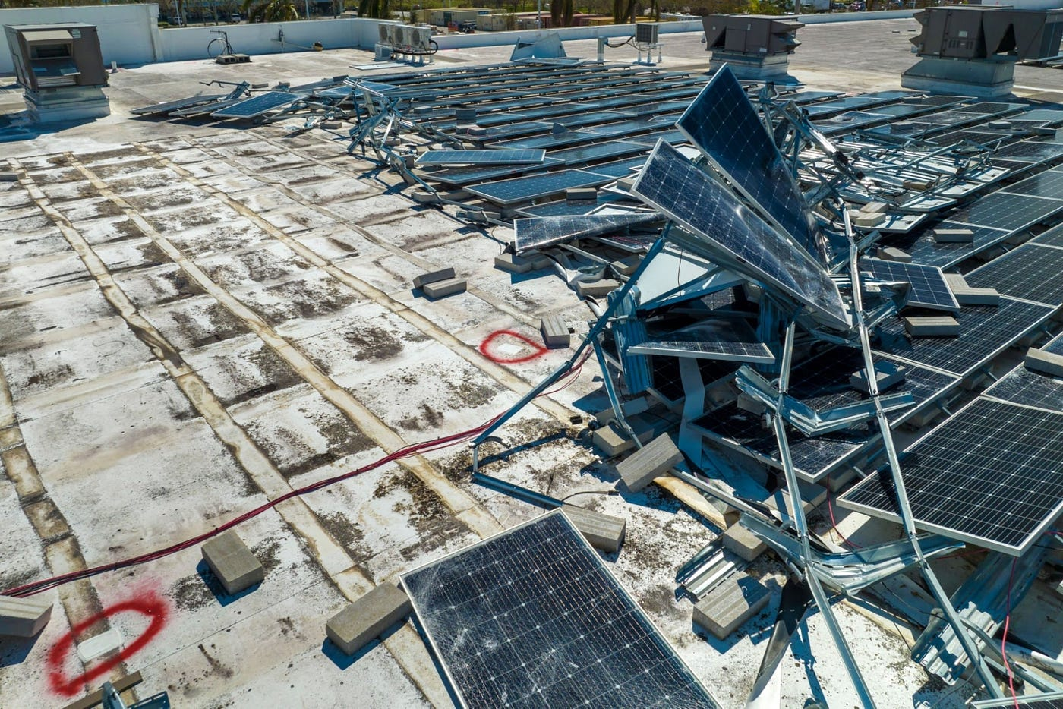
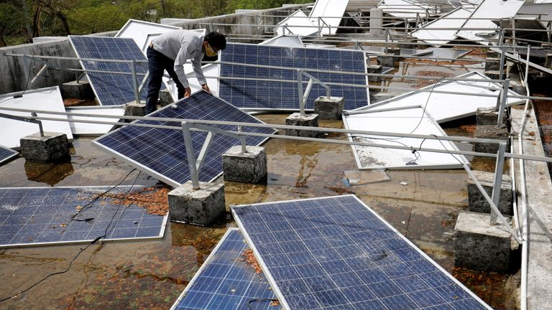
INTRODUCTION
Solar panels are key to renewable energy but face challenges with wind-induced loads.
Recent extreme weather (e.g., cyclones) have exposed limitations in current design standards.
Need for improved aerodynamic and structural design to ensure long-term performance.
Economic and environmental implications of damage and repairs.
Solar Panel damage from Cyclone Biparjoy (2023)
Solar Panel damage from Cyclone Tauktae (2021)

Slide 3
Solar panel dimensions: 0.600 × 0.500 × 0.020 meters.

Slide 4
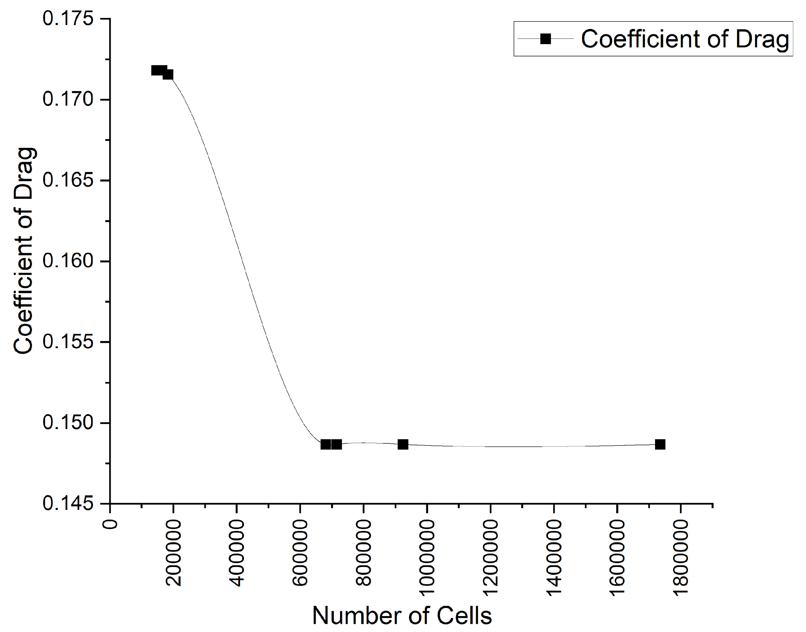
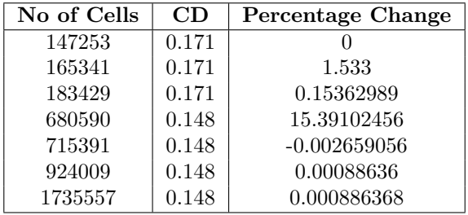
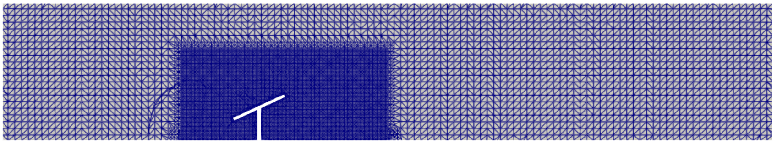
Mesh Convergence Table

Slide 5
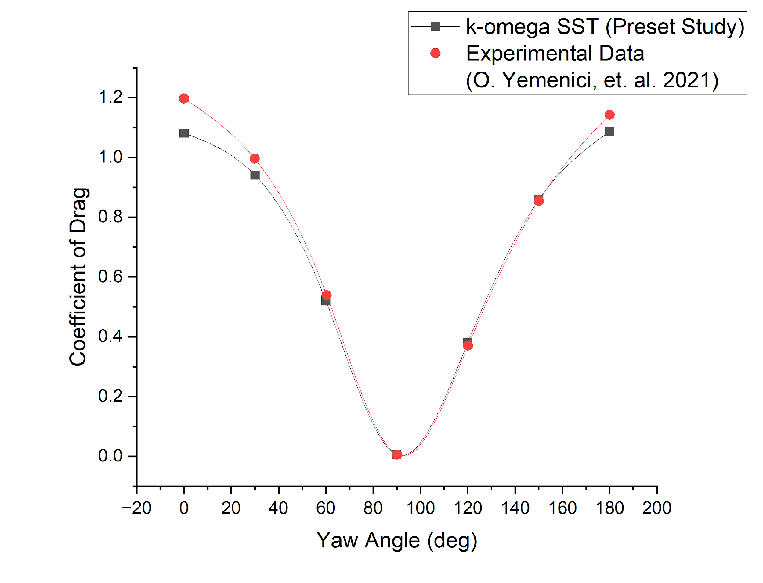
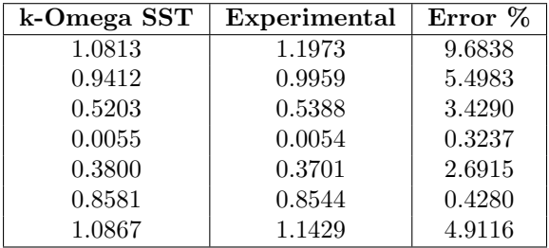
VALIDATION
Validation Table
Validation Graph, Simulation vs Experiment

Slide 6
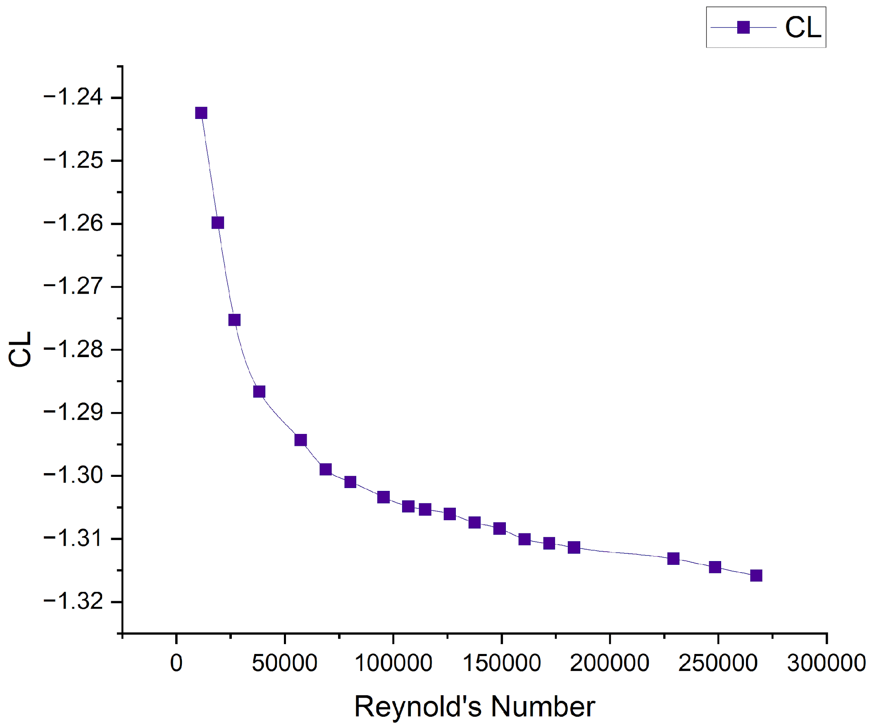
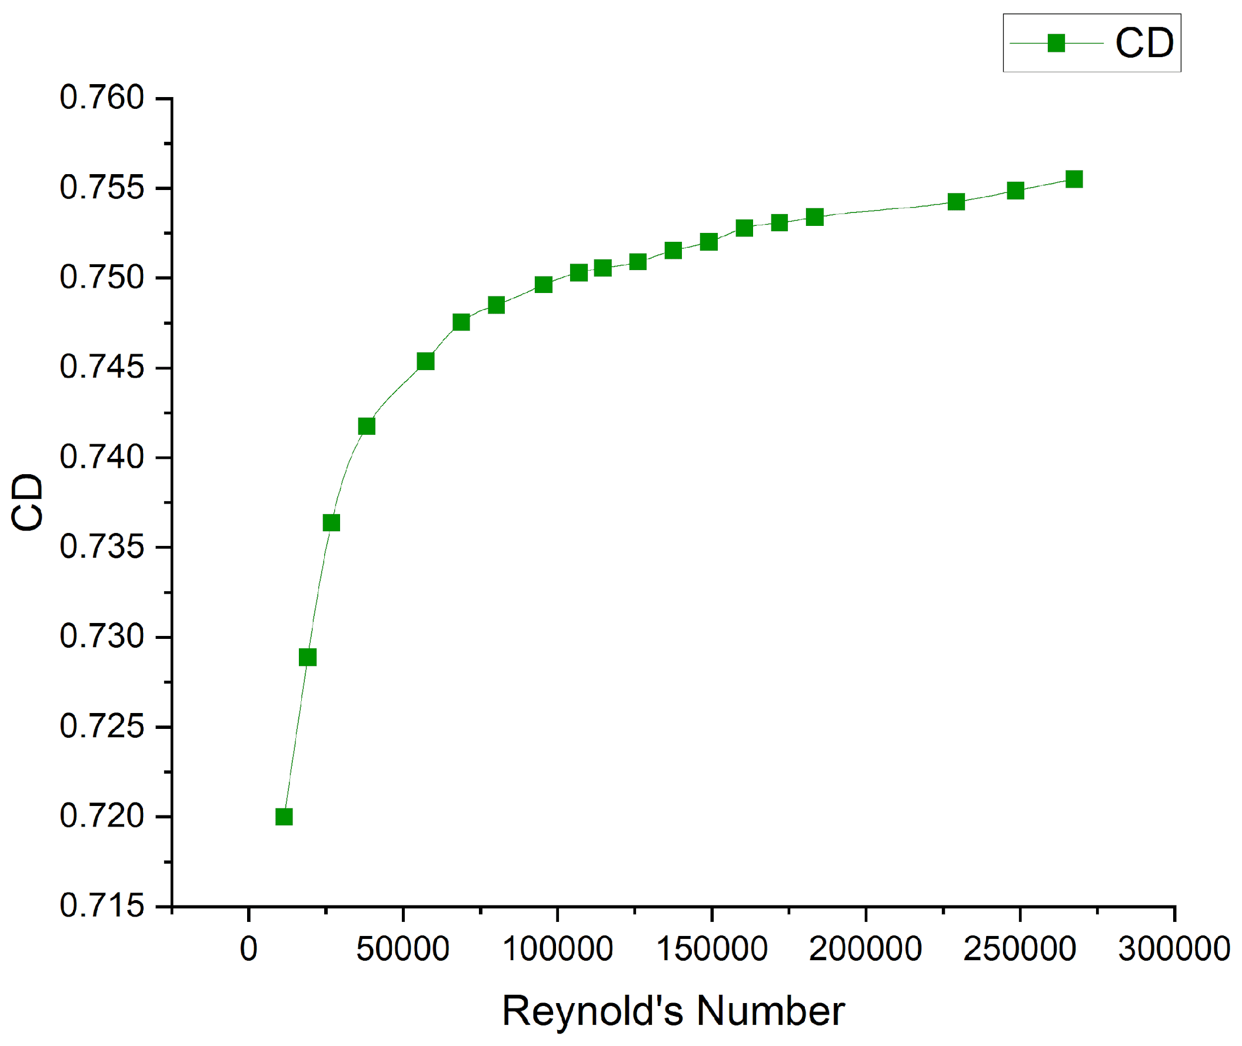
Reynolds Number vs CL
Reynolds Number vs CD
Velocity normalized into Reynolds Number.
Drag Coefficient (CD) increases with wind speed
Lift Coefficient (CL) shows decreasing trend

Slide 7
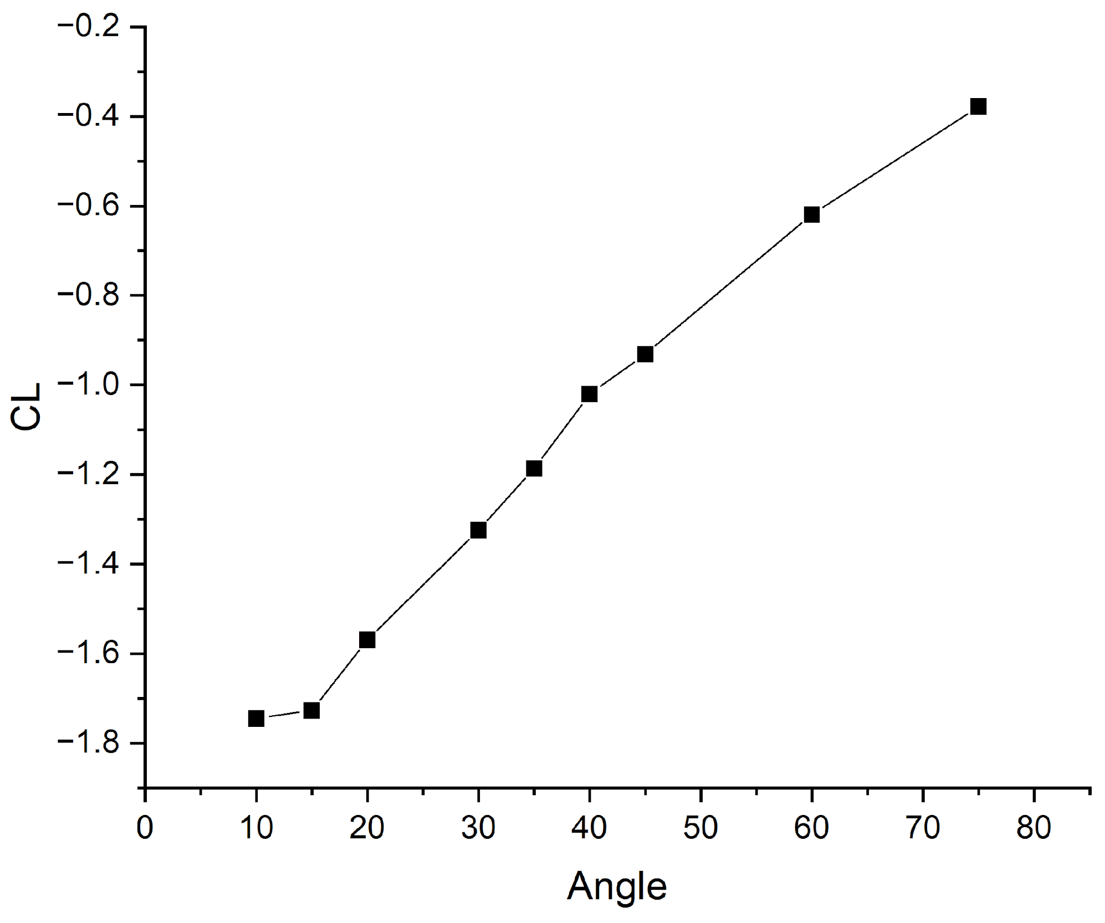
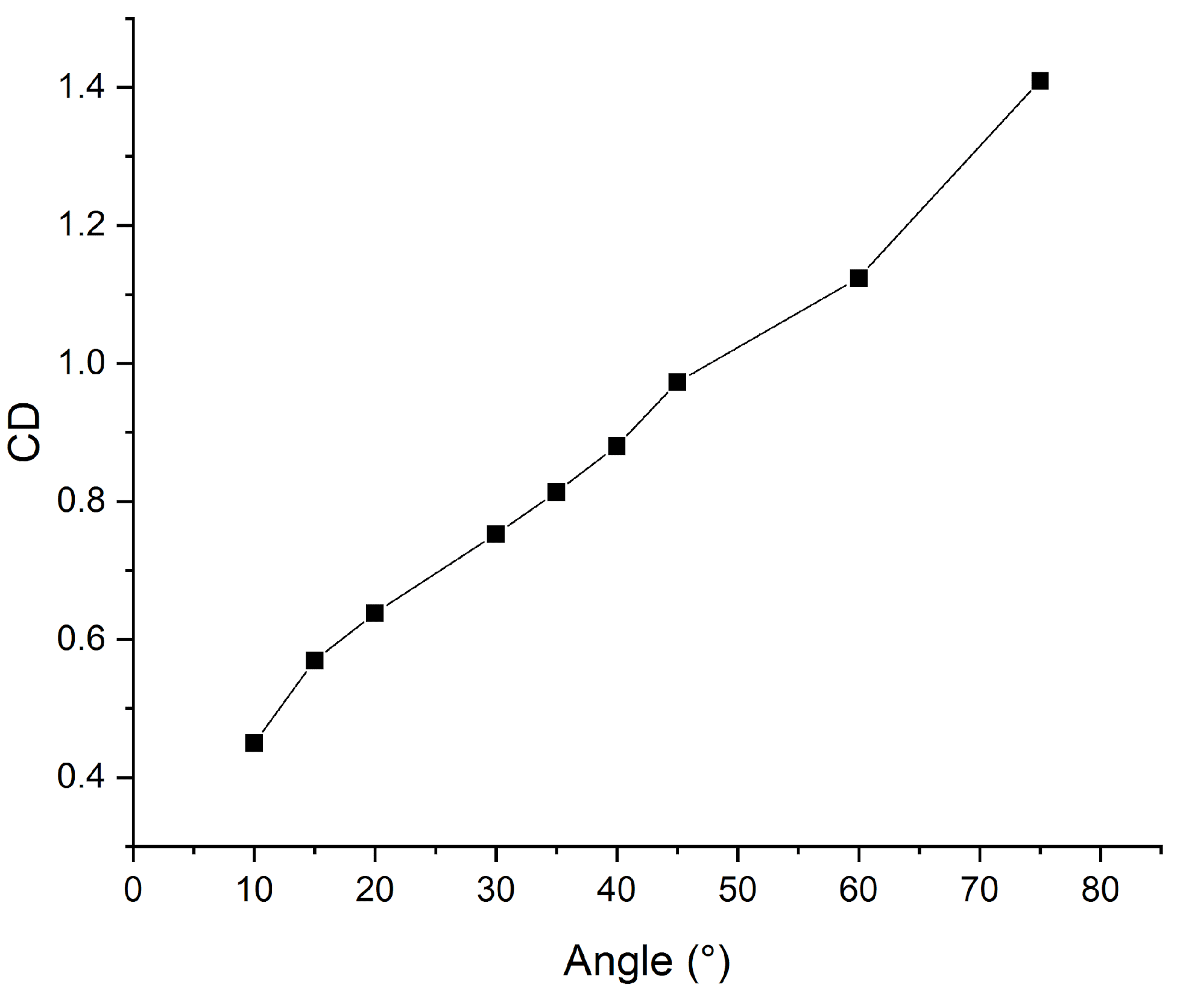
Tilt Angle vs CL
Tilt Angle vs CD
Analysis from 0° to 75° tilt.
Optimal tilt around 30° where drag is minimized while capturing sufficient irradiance.

Slide 8
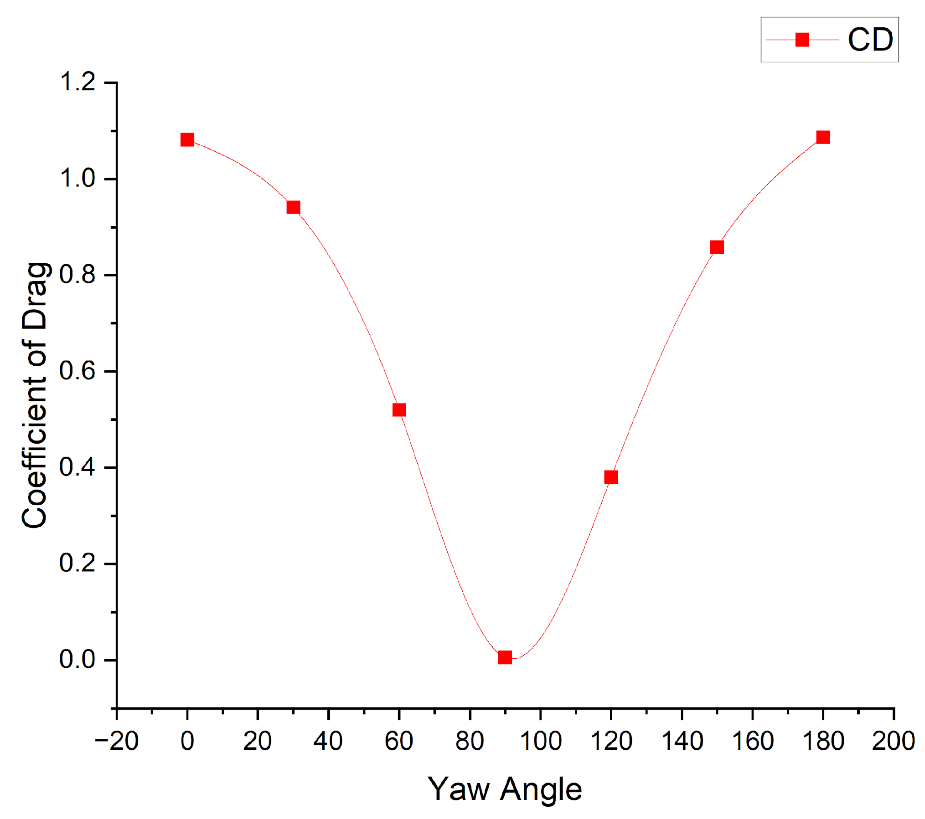
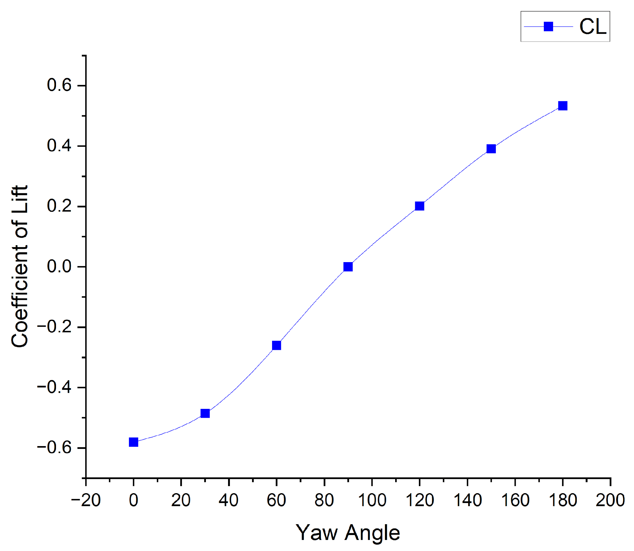
CD vs Yaw Angle
CL vs Yaw Angle
Effects of different wind attack angles on force distribution.
Notable increase in drag at intermediate yaw (e.g., 30°) and reduction at extreme angles.

Slide 9
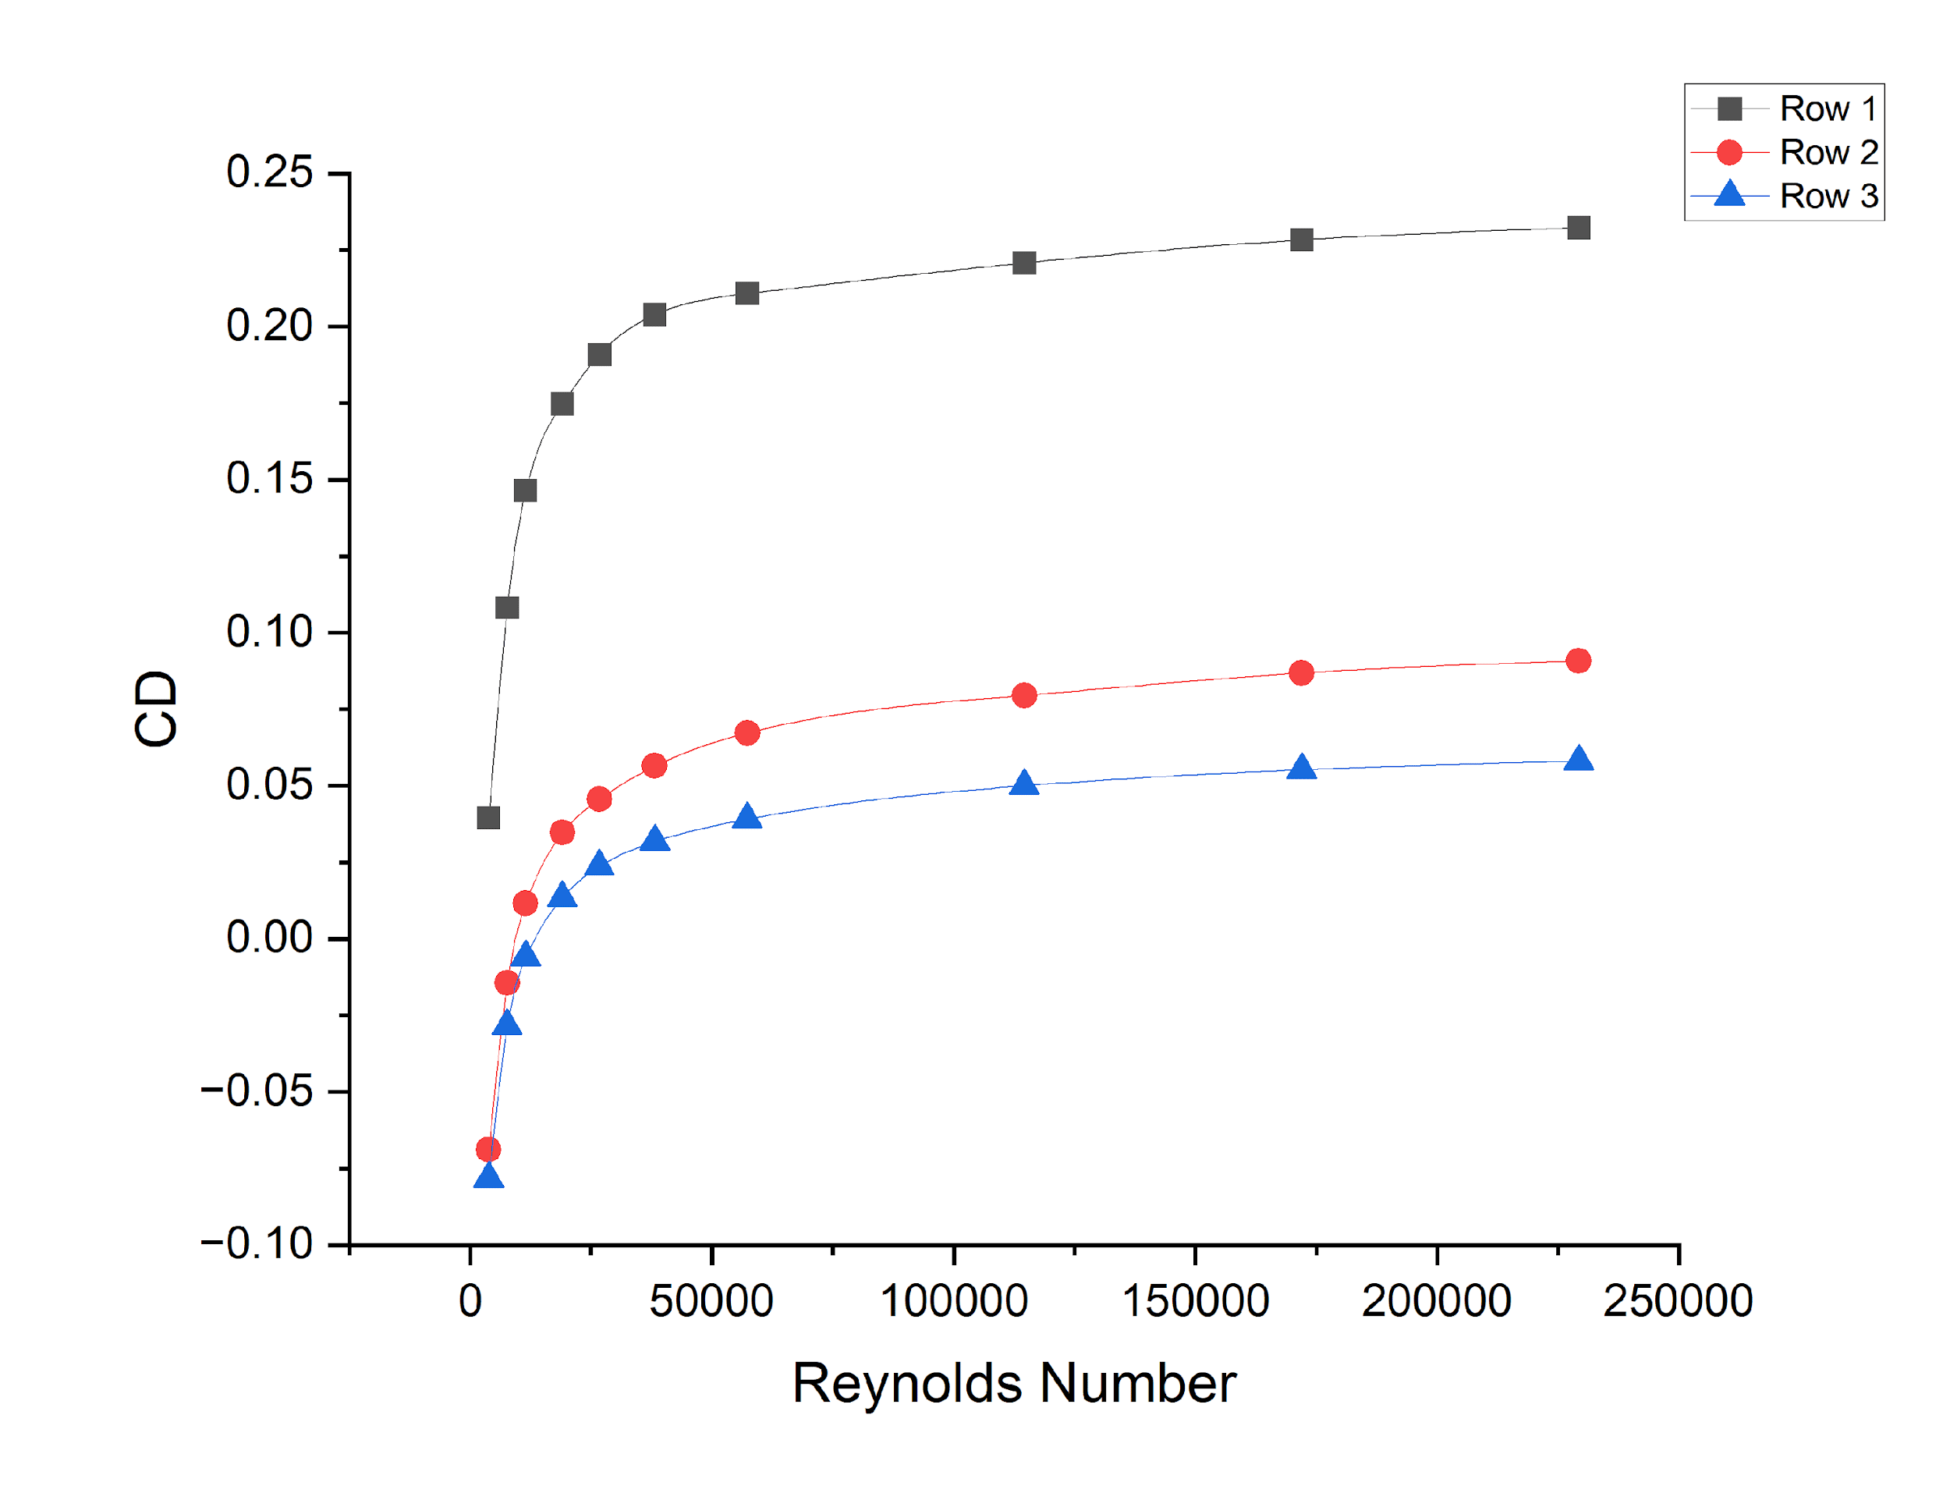
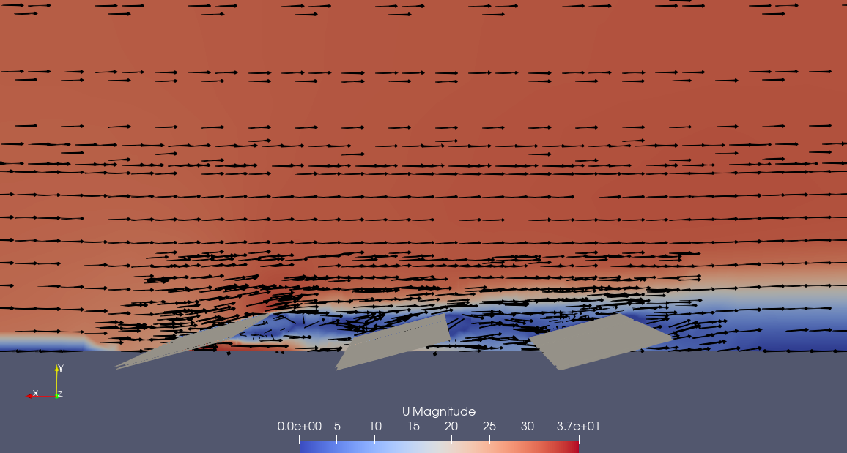
SHELTERING EFFECT IN ARRAYS
Quantization of Sheltering Effect
Visual of Observed Sheltering Effect
Sheltering is observed.
Quantitative reduction in drag forces (45–60% lower in trailing rows)

Slide 10
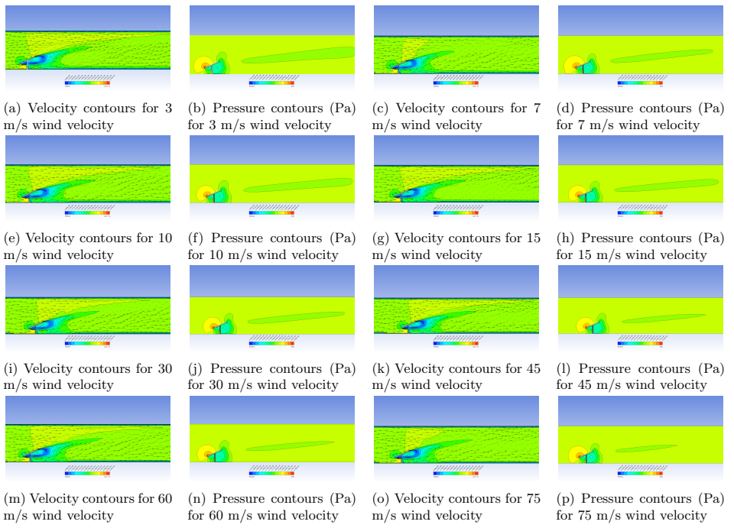

Slide 11
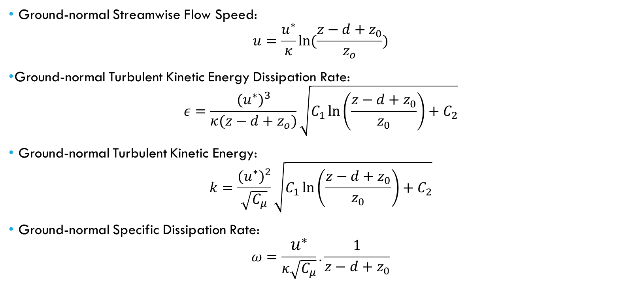

Slide 12
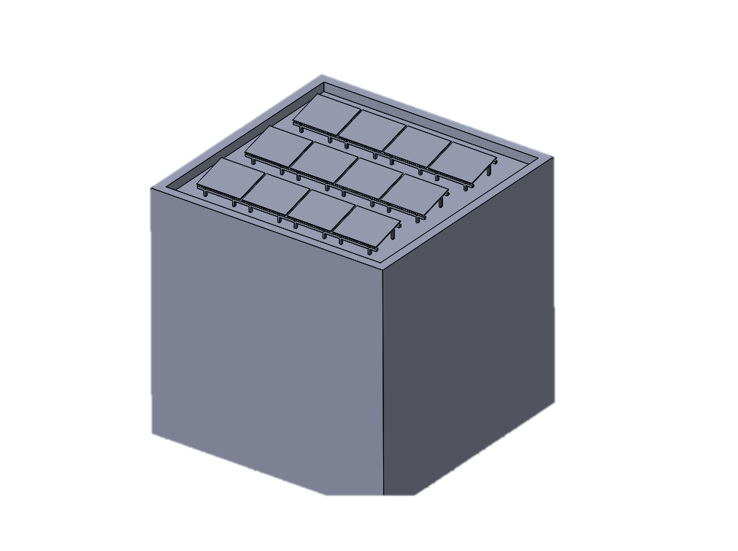
ROOF MOUNTED SOLAR PANELS
The model represents a building rooftop with multiple rows of solar panels arranged at a specified tilt.
Includes parapet for wind sheltering
Roof Mounted Solar Panel

